Slide 1
Minesight Velosphere
216
What the Hack
Bin Fang
Hao Zhang
Mario Sanguinet
Briann Belliveau
Annie Phan
Wanlin Gong
Julia Morlock
Notes:
Briann Belliveau, Ian Pierce, Wanlin Gong, Julia Morlock, Annie Phan, Sushma Nagalapuram, Mario Sanguinet, Deborah Milam

Slide 2
Provide
intervention recommendations &
policy changes
?

Slide 3




Heart Disease
Socioeconomic Factors
Social Services
Education
Notes:
Heart disease & impact on/from:
Social services
Education
socioeconomic factors

Slide 4
So what?
Why it matters...

Slide 5
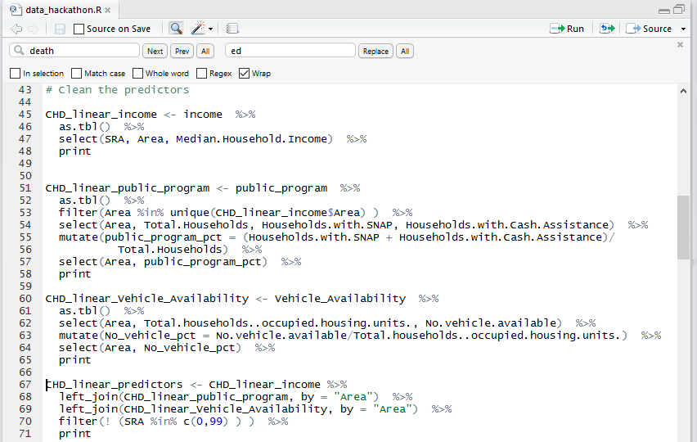
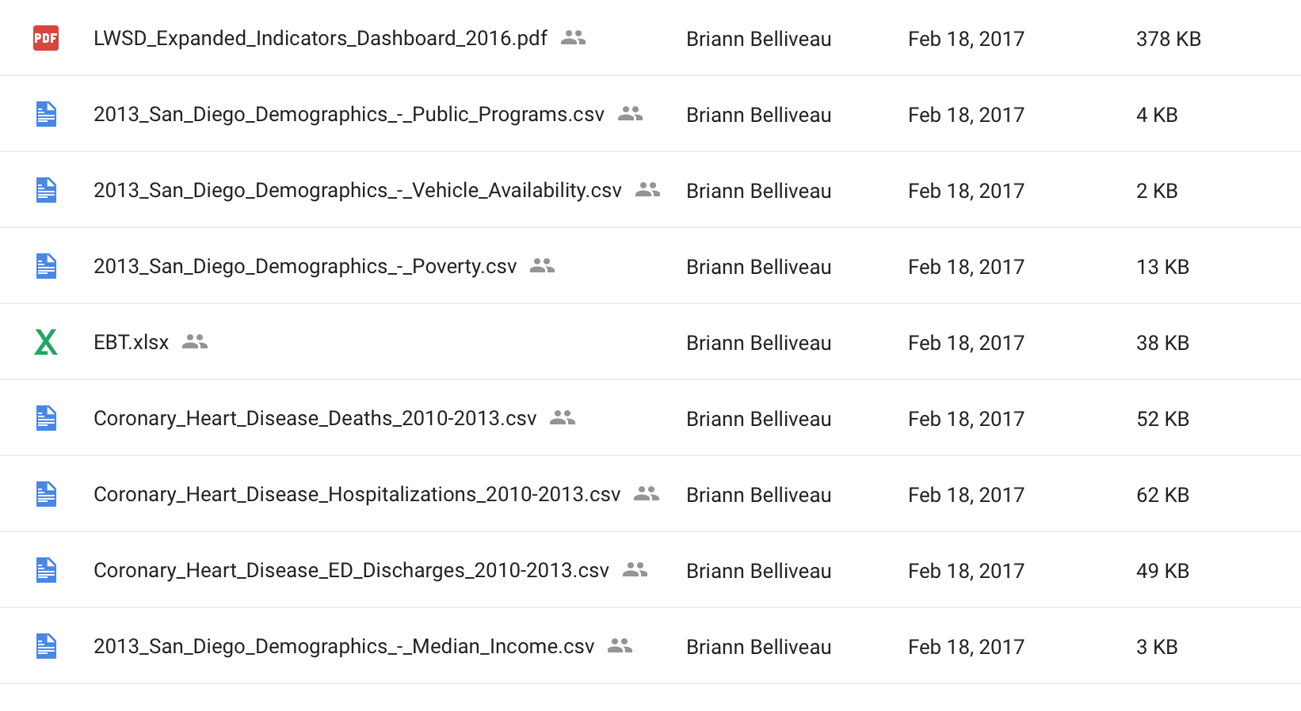
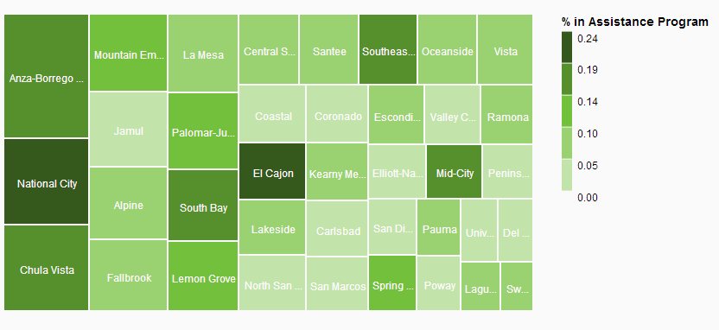
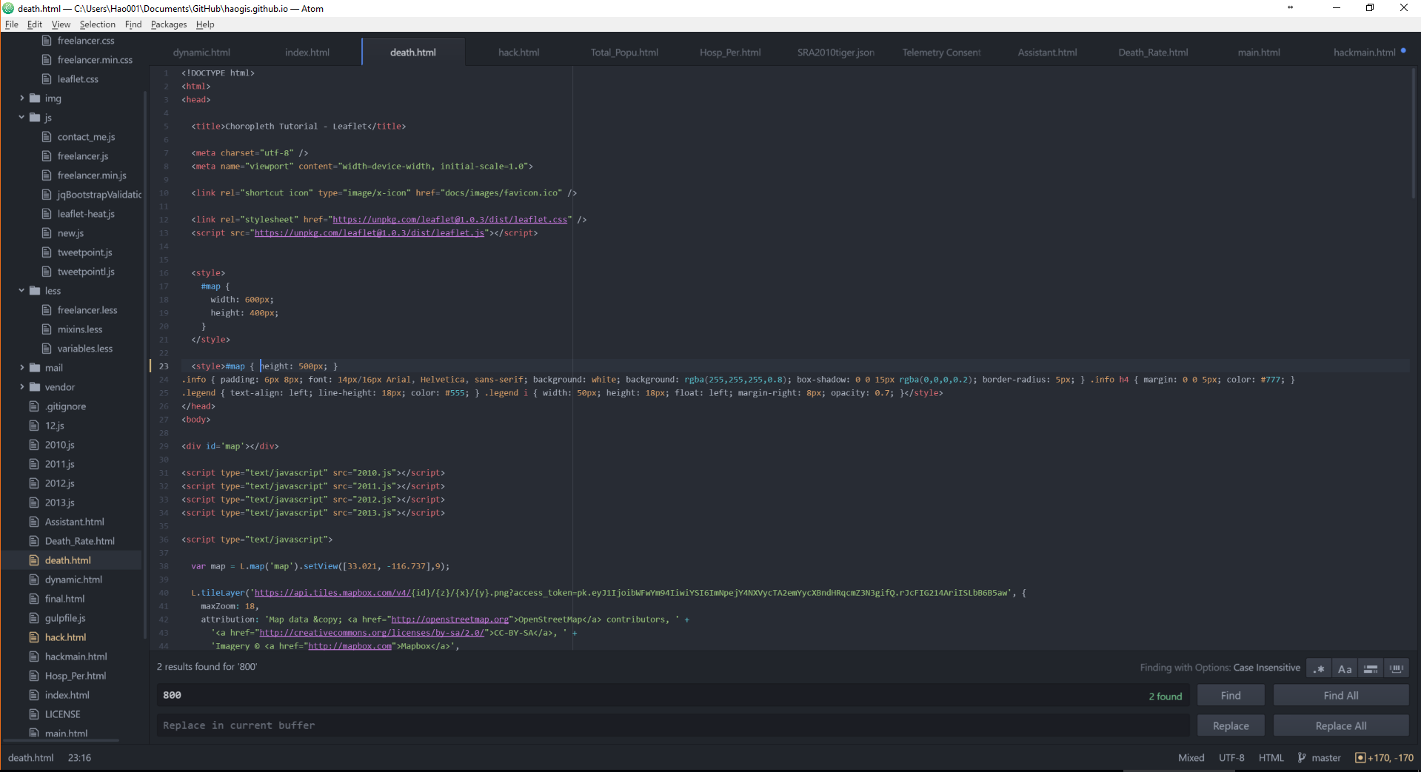
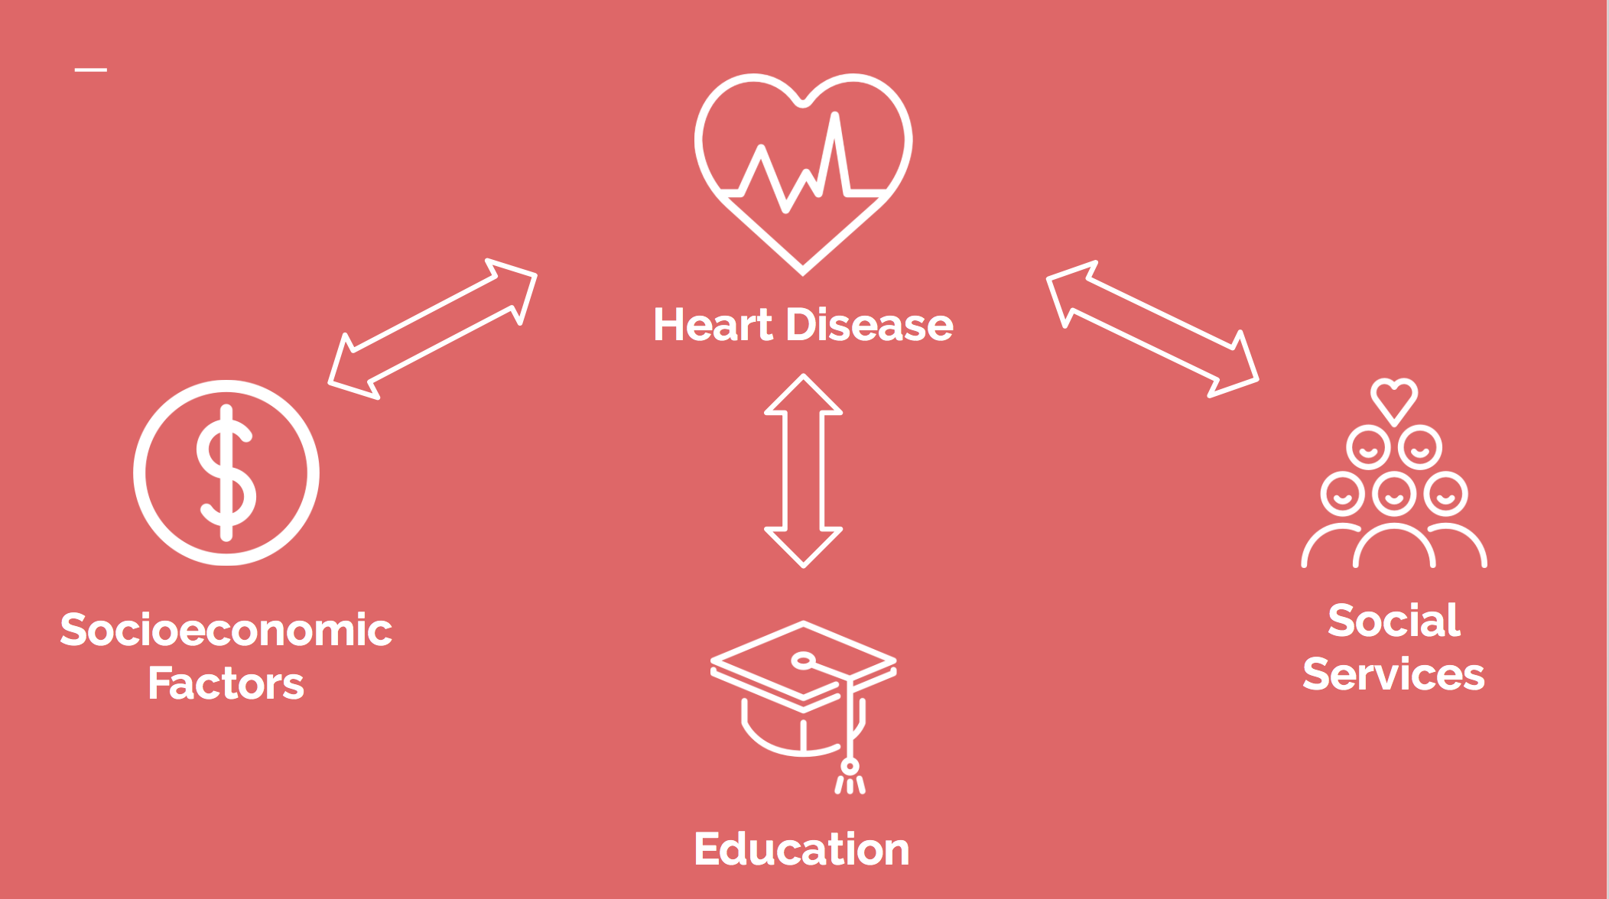
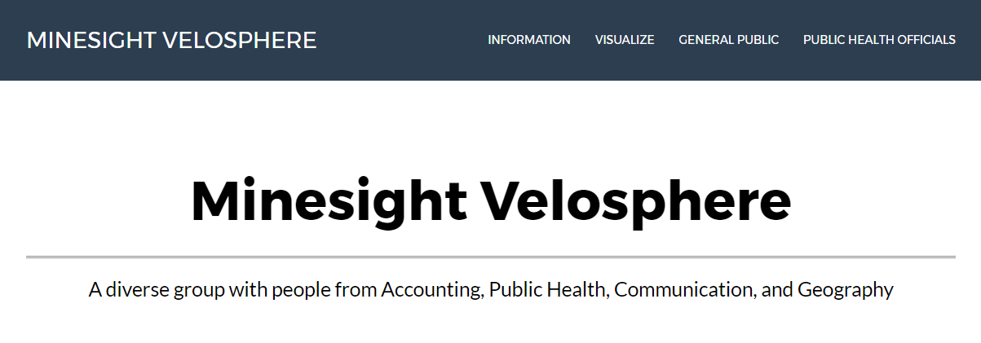
Teamwork makes the dream work…
Briann Belliveau
Data Acquisition
Bin Fang
Data Cleaning w/ R
Wanlin Gong & Julia Morlock
Data Visualization w/ SAP Predictive Analytics
Annie Phan - Website Design
Hao Zhang
Website Development w/ HTML, Java Script, Leaflet
Mario Sanguinet
Visuals & Presentation

Slide 6



Target Users
Impact
Next Steps
Governments
Policy Makers
Funding Allocation
Resource Usage
Scaling up
Notes:
Briann Belliveau, Ian Pierce, Wanlin Gong, Julia Morlock, Annie Phan, Sushma Nagalapuram, Mario Sanguinet, Deborah Milam

